Slide 1
ANATOMY OF THE ANAL CANAL
BY
DR. OJEWALE A.O

Slide 2
Outline
Intro’
Location
Extent
Relations
Interior of the Anal canal
Arterial supply
Venous drainage
Lymphatic drainage
Applied Anatomy

Slide 3
Intro’
The anal canal is the terminal part (4 cm long) of the large intestine, situated in the perineum below the pelvic diaphragm.
It is devoid of sacculations, taenia coli, and appendices epiploicae like rectum.
It is surrounded by an inner involuntary sphincter and an outer voluntary sphincter, whose tone keeps the anal canal closed except during the defecation.

Slide 4
Location
It is located in the anal triangle of the perineum between the right and left fat-filled ischiorectal fossae. These fossae allow the expansion of the anal canal during defecation.

Slide 5
Extent and Course
It begins at the anorectal junction, passes downward and backward, and opens at the anal orifice, which is situated in the natal cleft (cleft between the buttocks) about 4 cm below and in front of the tip of coccyx.
The skin surrounding the anal orifice is pigmented and thrown into radiating folds due to a pull exerted by underlying subcutaneous muscle-the corrugator cutis ani.

Slide 6
Cont’d
The anorectal junction is surrounded by puborectalis which pulls it forward producing, forward convexity and backward bend of 90° (perineal flexure).

Slide 7
Relations of the Anal canal
Anteriorly:
Perineal body.
Bulb of penis and spongy urethra in male and lower part of the vagina in female.
Posteriorly:
Anococcygeal raphe.
Tip of coccyx.
Fibrofatty tissue between the perineal skin and the anococcygeal raphe.
Laterally (on each side): Ischiorectal fossa.

Slide 8
Interior of the Anal canal
It is divided into upper and lower parts by the pectinate line. The pectinate line represents the embryological site of attachment of the anal membrane.
The upper part of the anal canal extends from the anorectal junction to the pectinate line; and the lower part of the anal canal extends from the pectinate line to the anal verge.
The upper and lower parts of the anal canal are different in development, blood supply, lymphatic drainage, and nerve supply.

Slide 9
Differences between the upper and lower anal canals
Features | Upper anal canal | Lower anal canal
Development | Endoderm of the hind gut | Ectoderm of proctodeum
Epithelial lining | Simple columnar | Stratified squamous
Arterial supply | Superior rectal artery | Inferior rectal artery
Venous drainage | Superior rectal vein draining into portal system | Inferior rectal vein draining into caval system
Innervation | Autonomic nerves, hence insensitive to pain, and temperature | Somatic nerves, hence sensitive to pain, and temperature
Lymphatic drainage | Internal iliac lymph nodes | Superficial inguinal lymph nodes
Hemorrhoids | Internal hemorrhoids | External hemorrhoids

Slide 10
Features in the Upper part of Anal canal
The upper part of the anal canal (1.5 cm long) presents the following features:
Anal columns (columns of Morgagni):These are permanent longitudinal folds of the mucous membrane numbering 6 to 10. They contain radicles of the superior rectal vein.
Anal valves (valves of Morgagni):These are crescentic folds of the mucous membrane which connect the lower ends of adjacent anal columns. The free margins of these valves are directed upward. The position of these valves is indicated by the wavy pectinate line (also called dentate line).

Slide 11
Cont’d
Anal sinuses: These are vertical recesses between the anal columns and above the anal valves. The ducts of tubular anal glands present in the submucosa open in the floor of anal sinuses.

Slide 12
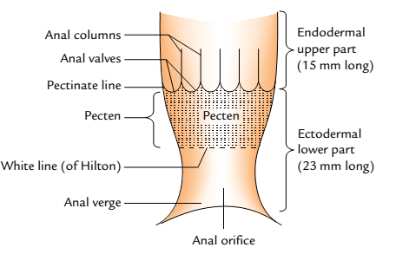
Cont’d

Slide 13
Features in the lower part of anal canal
The lower part of the anal canal is further divided into two regions: upper and lower.
Upper region of lower anal canal: It is 1.5 cm long and extends from the pectinate line to Hilton’s line. It is lined by the stratified squamous (non-keratinized) epithelium. The mucous lining in this region appears bluish in colour due to underlying dense venous plexus and is attached to the underlying structures.
Lower region of lower anal canal: It is about 0.8 cm in extent and lined by the true skin containing sweat and sebaceous gland. It shows pigmentation. In adult males, coarse hairs are often found around the anal orifice.

Slide 14
Cont’d
Hilton’s line: It is situated at the junction of the subcutaneous external anal sphincter and the lower end of internal anal sphincter, and represented by the anal intersphincteric groove. It presents the following features:
It separates mucocutaneous junction.
It appears white because, it lies between the bluish pinkish area above and blackish skin below, hence the name white line of Hilton.

Slide 15
Anal sphincters
There are two sphincters, (internal and external), around the anal canal, which provide powerful sphincteric mechanism at the distal end of the gastrointestinal tract.
INTERNAL ANAL SPHINCTER
It is formed by thickened circular muscle coat of the anal canal and surrounds the upper two-third of the canal.
Above, it is continuous with the circular muscle coat of the rectum and below reaches up to the level of the white line of Hilton.
It is surrounded by the deep and superficial parts of the external anal sphincter.

Slide 16
Cont’d
EXTERNAL ANAL SPHINCTER
The external anal sphincter surrounds the whole length of the anal canal and consists of three parts: deep, superficial, and subcutaneous.

Slide 17
Cont’d
Deep Part
The deep part surrounds the upper part of the internal anal sphincter. It has no bony attachments. The puborectalis blends with the deep part of external anal sphincter behind and forms a sling around the anorectal junction, which is attached anteriorly to the back of the pubis. In the resting state, the anorectal tube is angled forward at this level and contraction of puborectalis sling will increase this angle, an important factor in the continence mechanism.

Slide 18
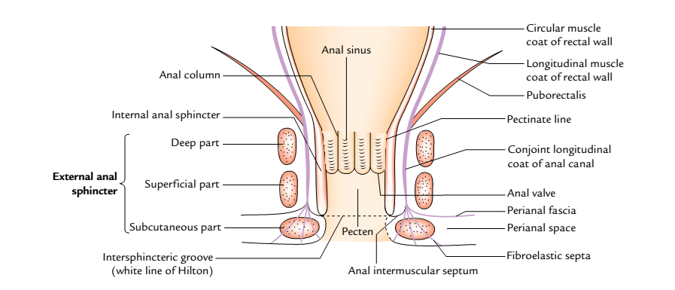
Cont’d
A coronal section of anal canal showing internal and external anal sphincters

Slide 19
Cont’d
Superficial Part
It is oval in shape. It arises from the tip of coccyx and anococcygeal raphe behind, surrounds the lower part of internal sphincter and then gets inserted into the perineal body in front.
Subcutaneous Part
The subcutaneous part lies below the internal sphincter in the perianal space and surrounds the lower part of the anal canal. It has the form of flat band, about 1.5 cm broad. It has no bony attachment.

Slide 20
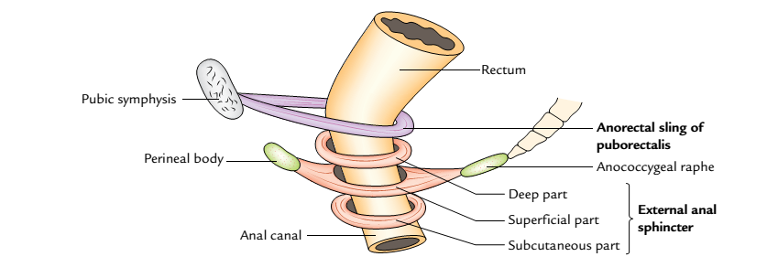
Cont’d
Anorectal sling and different parts of the external anal sphincters

Slide 21
Cont’d
It is traversed by fibroblastic septa derived from the conjoint longitudinal coat.
Nerve Supply of the Sphincter
The internal sphincter is made up of smooth muscle and supplied by the autonomic nerve fibres (sympathetic and parasympathetic), hence it is involuntary.
The external anal sphincter is made up of striated muscle and hence, supplied by the somatic nerve-inferior rectal nerve and perineal branch of 4th sacral nerve. It is therefore under voluntary control.

Slide 22
Arterial Supply & Venous drainage
The upper part of anal canal is supplied by the superior rectal artery and the lower part of anal canal is supplied by the inferior rectal artery.
The upper part of the anal canal is drained into the portal venous system by the superior rectal vein and the lower part of the anal canal is drained into the caval (systemic) system by inferior rectal veins.

Slide 23
Lymphatic drainage
The upper part of the anal canal drains into the internal iliac lymph nodes whereas the lower part drains into the horizontal group of superficial inguinal lymph nodes. Therefore, the pectinate line forms the “water shed line”of the anal canal.

Slide 24
Applied Anatomy
Hemorrhoids (or piles):These are variceal dilatations of the submucosal anal and perianal venous plexuses. They are classified into two types:
Internal hemorrhoids (true piles):These are the saccular dilatations of the tributaries of the superior rectal (hemorrhoidal) vein above the pectinate line in portal obstruction.

Slide 25
Cont’d
The internal hemorrhoids may be primary or secondary. The primary piles are formed due to dilatations of main tributaries/radicles of the superior rectal vein which lie in the anal columns which occupy the left lateral, right posterior, and right anterior positions. The dilatations of radicles of superior rectal vein in other positions are termed secondary piles.

Slide 26
Cont’d
The location of primary piles corresponds to the 3 o’clock, 7 o’clock, and 11 o’clock positions of the anal wall, when viewing the interior of anal canal in lithotomy position.
Anatomically, each hemorrhoids/pile consists of a fold of mucosa and submucosa containing a varicose radicle of the superior rectal vein and a terminal branch of the superior rectal artery.

Slide 27
Cont’d
They are painless but bleed profusely on straining during defecation (passing stool).
Types: Initially they are confined within the anal canal (1st degree), gradually they enlarge and prolapse during defecation (2nd degree), and finally remain prolapsed (3rd degree).

Slide 28
Cont’d
External hemorrhoids (false piles):These are dilatations of the tributaries of inferior rectal vein below the pectinate line. They are covered by the mucous membrane of the lower half of the canal.
They are very painful and do not bleed on straining during defecation.
The so-called thrombosed external pile is a small tense hematoma at the anal margin caused due to rupture of the subcutaneous vein. Therefore, it should be truly termed perianal hematoma.

Slide 29
Cont’d
Fissure in anorectal canal: It is caused by rupture of one of the anal valves (valves of Morgagni) by the passage of hard fecal mass. They occur posteriorly in the midline and are very painful because the inferior aspect of the valve is lined by the mucous membrane/skin of the lower half of anal canal supplied by the somatic nerves.

Slide 30
Cont’d
Fistula in anorectal canal: It is caused by the rupture of an abscess around the canal. The abscess opens spontaneously internally into the anal canal and externally on the surface and the track becomes epithelialized. Low-level anal fistula passing through the lower part of the superficial anal sphincter is the most common.

Slide 31


